Slide 1


Slide 2






MEET THE TEAM
Anirudh Ravikumar Nair
CSO
Riju Humagain
COO
Subodh Kadam
CEO
Denzil Ritesh
CDO
Pranali Pradeep Pawar
CFO
Akshitha Mohan Shirva
CIO

Slide 3




ABOUT US
We are a meal kit delivery service
We provide personalized recipes and pre-portion fresh ingredients
We tailor to each customer’s taste preferences and dietary needs
We use AI algorithms to analyze user data and continuously improve our recommendations

Slide 4
OUR MISSION
We redefine home cooking with a seamless, personalized culinary experience, simplifying mealtimes for individuals and families worldwide. Through tailored guidance, intuitive technology, and sustainable solutions, we promote healthier habits and ignite culinary creativity
OUR VISION
To inspire healthier, happier lives through effortless and creative cooking in every kitchen worldwide

Slide 5
MARKET SURVEY - VIABILITY
Would you be interested in subscribing to a meal kit service with the features listed earlier?
47%
Definitely Yes!
40%
Maybe
8%
No
5%
Not Sure

Slide 6
MARKET SURVEY - VIABILITY
What are your biggest concerns about using a meal kit service?
68%
Cost
19%
Variety
13%
Commitment

Slide 7
MARKET SURVEY - FEATURES
What features are appealing to you in this meal kit service concept?
(multiple selection)
64%
Recipe Suggestions based on genAI algorithms
51%
Holiday Meals
52%
Ability to order groceries as an add on
71%
Personalization Plan

Slide 8
MARKET SURVEY - FEATURES
What additional features would you like to see with your meal kit service? (multiple selection)
75%
Grocery Integration
82%
Interactive cooking tutorials (guided by AI)
24%
Progress tracking & recipe difficulty levels (personalized learning)
53%
Social platform (share recipes, tips, and leftover hacks)

Slide 9
MARKET SURVEY – TARGET MARKET
How much would you be willing to pay per meal for a service like this?
50%
$5 - $7 per serving
46%
$8 - $10 per serving
3%
$11 - $13 per serving
1%
$14 - $16 per serving

Slide 10
MARKET SURVEY – TARGET MARKET
Interest in Meal kit by Age Group
100%
18-24 years old
84%
25-34 years old
62%
35-44 years old
48%
45-54 years old

Slide 11

PRODUCT ROADMAP
2024
Q1
Q2
Q3
Q4
Product Launch
October 1, 2024
in Texas
Product Development - AI
Product Development - Recipes
Product Development
AI Algorithm: Personalized recipe suggestions based on user preference and available inventory
-Data Collection and Analysis
-Machine Learning Algorithms
-Dynamic Adaptation
Develop a Community Platform: A social engagement site
Nutritional Guidance Implementation: Establish a nutritional database and implement features for personalized dietary recommendations
Seasonal and Holiday Offerings: Introduce special menus and offer diverse cuisines
Interactive Cooking Guides: Step–by–step instructions and video tutorials to enhance the cooking experience
Community Platform Launch: Users can share recipes and cooking tips to engage with each other

Slide 12
PRODUCT ROADMAP
2025
Q5
Q6
Q7
Q8
Aftermarket Feature Development
Aftermarket Feature Launch
Aftermarket Feature Launch
Aftermarket Feature Launch
Smart Gadget Integration
National Expansion
Grocery Delivery Integration
AR Experience: Interactive Cooking Guides
VR Experience: Virtual Cooking Demonstration
Ready to Eat Meals
Exclusive Eats
Smart Gadget Integration: Voice-activated commands and virtual assistant for hands-free interaction
AR Experience: Interactive Cooking Guides
AR instructions within SmartPlate app for an interactive cooking experience
VR Experience: Virtual Cooking Demonstration
Aftermarket Feature Development
Aftermarket Feature Development
Grocery Delivery Integration: Seamless ingredient shopping and delivery
National Expansion: Optimize supply chain, scale up sourcing and logistics infrastructure
Exclusive Eats: Partner with restaurants to offer branded meal kits featuring signature dishes.
Ready-To-Eat-Meals Services: Partner with local providers to introduce ready-to-eat meals
Aftermarket Feature Development
Global Expansion: Partnership with local farmers, groceries; scale up logistics, language support

Slide 13





PRODUCT JOURNEY
Producers

Slide 14
PRODUCT JOURNEY
Processing Warehouse

Slide 15
PRODUCT JOURNEY
Mini Distribution Centers

Slide 16
PRODUCT JOURNEY
Consumer

Slide 17
INNOVATION
Smart Gadget Integration
Develop a comprehensive smart gadget integration with devices such as Apple Watch and Apple Vision Pro to help elevate the cooking experience
Virtual Culinary Assistant
Adaptive AI
Experience immersive virtual cooking sessions led by professional chefs in a virtual kitchen, offering unique culinary experiences and learning opportunities
Utilize machine learning algorithms to continuously adapt and optimize recipe suggestions, cooking tips, and culinary experiences

Slide 18
Personalized Meal Planning
Sustainable Culinary Platform
Offer smart ingredient substitution and modification features that suggest alternative ingredients and recipes based on the available inventory, dietary preferences and user’s needs
Organic and sustainable ingredients sourced directly from producers and provide detailed information about the source, farming practices and quality of the products to ensure a sense of trust among the customers
Global Culinary Marketplace and Community
Create a platform offering a curated selection of global and local ingredients, cuisines, recipes, meal kits, and culinary experiences, and fostering a vibrant and interactive global culinary community
DISRUPTIVE INNOVATION

Slide 19
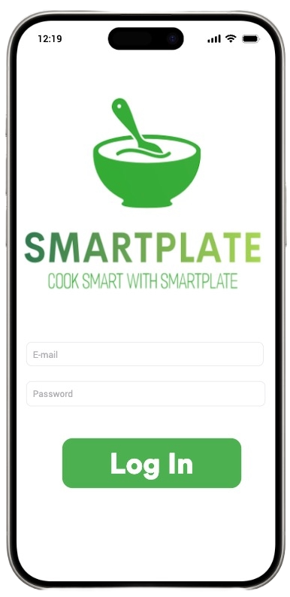
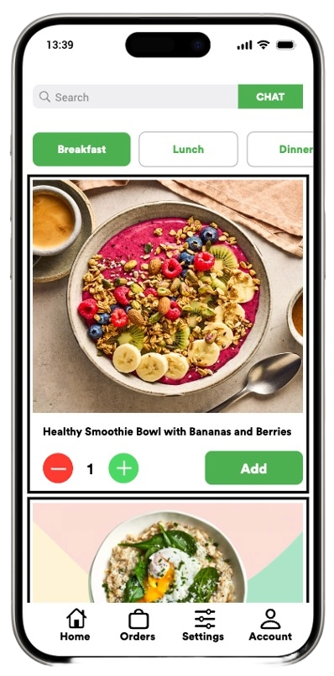
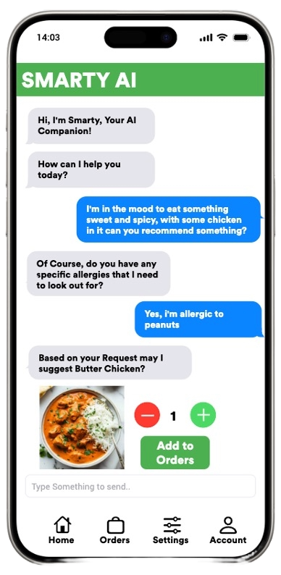
USER INTERFACE

Slide 20






04
03
02
01
4
SOCIAL SHARING AND COMMUNITY
EXCLUSIVE EATS
CONVENIENT AND PERSONALIZED MEAL SOLUTIONS
AI GUIDED INTERACTIVE COOKING
3
STICKINESS
Distinct signature dishes from restaurants to the comfort of your own home for varied and diversified meal experience
Sharing cooking experiences
Building community engagement and brand loyalty
Grocery Delivery Integration for seamless ingredient delivery
Ready-To-Eat-Meals Services for convenient meal options for busy professionals.
Smart Gadget Integration with voice-activated commands for hands-free cooking
Interactive AR/VR Cooking Guide for step-by-step cooking demonstration
2
1

Slide 21
04
03
02
01
4
SOCIAL SHARING AND COMMUNITY
EXCLUSIVE EATS
CONVENIENT AND PERSONALIZED MEAL SOLUTIONS
AI GUIDED INTERACTIVE COOKING
3
Distinct signature dishes from restaurants to the comfort of your own home for varied and diversified meal experience
Sharing cooking experiences
Building community engagement and brand loyalty
Grocery Delivery Integration for seamless ingredient delivery
Ready-To-Eat-Meals Services for convenient meal options for busy professionals.
Smart Gadget Integration with voice-activated commands for hands-free cooking
Interactive AR/VR Cooking Guide for step-by-step cooking demonstration
STICKINESS
2
1

Slide 22
04
03
02
01
4
SOCIAL SHARING AND COMMUNITY
EXCLUSIVE EATS
CONVENIENT AND PERSONALIZED MEAL SOLUTIONS
AI GUIDED INTERACTIVE COOKING
3
Distinct signature dishes from restaurants to the comfort of your own home for varied and diversified meal experience
Sharing cooking experiences
Building community engagement and brand loyalty
Grocery Delivery Integration for seamless ingredient delivery
Ready-To-Eat-Meals Services for convenient meal options for busy professionals.
Smart Gadget Integration with voice-activated commands for hands-free cooking
Interactive AR/VR Cooking Guide for step-by-step cooking demonstration
STICKINESS
2
1

Slide 23
04
03
02
01
4
SOCIAL SHARING AND COMMUNITY
EXCLUSIVE EATS
CONVENIENT AND PERSONALIZED MEAL SOLUTIONS
AI GUIDED INTERACTIVE COOKING
3
Distinct signature dishes from restaurants to the comfort of your own home for varied and diversified meal experience
Sharing cooking experiences
Building community engagement and brand loyalty
Grocery Delivery Integration for seamless ingredient delivery
Ready-To-Eat-Meals Services for convenient meal options for busy professionals.
Smart Gadget Integration with voice-activated commands for hands-free cooking
Interactive AR/VR Cooking Guide for step-by-step cooking demonstration
STICKINESS
2
1

Slide 24
03
04
02
01
4
EXCLUSIVE EATS
SOCIAL SHARING AND COMMUNITY
CONVENIENT AND PERSONALIZED MEAL SOLUTIONS
AI GUIDED INTERACTIVE COOKING
3
Distinct signature dishes from restaurants to the comfort of your own home for varied and diversified meal experience
Sharing cooking experiences
Building community engagement and brand loyalty
Grocery Delivery Integration for seamless ingredient delivery
Ready-To-Eat-Meals Services for convenient meal options for busy professionals.
STICKINESS
Smart Gadget Integration with voice-activated commands for hands-free cooking
Interactive AR/VR Cooking Guide for step-by-step cooking demonstration
2
1

Slide 25



VALUE CREATION
CUSTOMERS
PARTNERS
RESTAURANTS
INVESTORS
Customization: Offers personalized recipe recommendations
Nutritional Guidance: Offers nutritional guidance and dietary recommendations
Community Engagement: Prompting users to share recipes, cooking tips, and experiences
Affordable Pricing: Option to subscribe to meal kits at an affordable price range
Increased Sales Visibility: Boost sales and visibility for grocery stores through streamlined delivery and quality ingredient offerings
Data-driven Insights: Offers insights into consumer trends, helping grocery partners optimize offerings
Brand Exposure: Allows restaurants to showcase signature dishes through branded meal kits
Revenue Generation: Generate additional revenue for restaurants, particularly during low dine-in traffic periods
Collaborative Innovation: Enables restaurants to innovate and adapt recipes for home cooking
Market Potential: Targets a growing market seeking convenient meal solutions and an affordable subscription model
Technology Advantage: AI and machine learning technology differentiate it from traditional meal kit services
Sustainable Growth: focus on sustainability, innovation, and community engagement showcases its commitment to long-term growth

Slide 26





Adjacent Market
Exponential Markets
Existing Markets
New Markets
SmartPlate's Global Expansion Potential: Our scalable business model and focus on innovation position’s it for global expansion, tapping into new markets and reaching a broader audience of consumers seeking convenient and personalized meal solutions.
The meal kit industry has significant growth potential, both domestically and internationally.
Grocery Delivery: Form partnerships with grocery stores and featured food brands. Earn commissions for customer referrals from the SmartPlate platform.
Ready Meals: Introduce a subscription service for ready-to-eat meals, offering various dietary preferences and cuisines. Include quick-prep options for added convenience
Meal Kit Overview: This industry has seen considerable growth with companies like HelloFresh and Blue Apron offering pre-portioned ingredients and recipes delivered to consumers' homes.
Convenience vs. Personalization: While these services provide convenience and variety, they often lack personalization and flexibility.
Challenges of Meeting Customer Preferences: Customers may receive recipes and ingredients that don't fully align with their preferences, leading to dissatisfaction and waste.
AI-Powered Personalization: By continuously learning and adapting, the AI ensures that users receive recipes tailored to their tastes and nutritional needs, enhancing satisfaction and engagement
Community Engagement Enhanced by AI: SmartPlate's AI-powered platform fosters community engagement by curating recipe sharing, cooking tips, and user interactions
Nutritional Guidance Enhanced with AI Insights: SmartPlate's AI algorithms provide personalized nutritional guidance based on user preferences and dietary requirements.
MARKET TYPES

Slide 27
Adjacent Market
Existing Markets
New Markets
Exponential Markets
SmartPlate's Global Expansion Potential: Our scalable business model and focus on innovation position’s it for global expansion, tapping into new markets and reaching a broader audience of consumers seeking convenient and personalized meal solutions.
The meal kit industry has significant growth potential, both domestically and internationally.
Meal Kit Overview: This industry has seen considerable growth with companies like HelloFresh and Blue Apron offering pre-portioned ingredients and recipes delivered to consumers' homes.
Convenience vs. Personalization: While these services provide convenience and variety, they often lack personalization and flexibility.
Challenges of Meeting Customer Preferences: Customers may receive recipes and ingredients that don't fully align with their preferences, leading to dissatisfaction and waste.
AI-Powered Personalization: By continuously learning and adapting, the AI ensures that users receive recipes tailored to their tastes and nutritional needs, enhancing satisfaction and engagement
Community Engagement Enhanced by AI: SmartPlate's AI-powered platform fosters community engagement by curating recipe sharing, cooking tips, and user interactions
Nutritional Guidance Enhanced with AI Insights: SmartPlate's AI algorithms provide personalized nutritional guidance based on user preferences and dietary requirements.
Grocery Delivery: Form partnerships with grocery stores and featured food brands. Earn commissions for customer referrals from the SmartPlate platform.
Ready Meals: Introduce a subscription service for ready-to-eat meals, offering various dietary preferences and cuisines. Include quick-prep options for added convenience
MARKET TYPES

Slide 28
MARKETING STRATEGY
Segmented Targeting and Personalization:
Segment market using customer data for targeted campaigns addressing unique needs: families, health enthusiasts, busy professionals
Content Marketing:
Craft robust content strategy: blogs, videos, articles on nutrition, sustainability, culinary skills. Establish SmartPlate as a leader in food tech and health.
Community Building and Engagement:
Foster a robust online community through forums and social media platforms where users can share recipes, cooking tips, and success stories. This community aspect can enhance customer loyalty and create a sense of belonging.
Partnerships and Collaborations:
Partner with influencers and chefs who can create unique recipes using SmartPlate meal kits and share these on their platforms. Ensure these partners align with SmartPlate’s brand values, especially around health, sustainability, and innovation.

Slide 29
















COMPETITORS
Meal Kit
EFFICIENT
Grocery
Ready to Eat

Slide 30

WAREHOUSE DISTRIBUTION MAP
LUBBOCK
DALLAS
WAREHOUSE/ SMART FACTORY
HOUSTON
- DISTRIBUTION CENTER

Slide 31
ESTIMATED MARKET SIZE AND TARGET MARKET
Population of people between the age of 18-45 in targeted areas (TAM): 5 million
Market penetration : 1%
Serviceable Available Market : 50,000 subscribers (Split over 5 Quarters)

Slide 32
SALES STRATEGY BUSINESS MODEL
INDIVIDUAL
ORGANIZATION
$6.59
Per Mealkit
$9.99
Per Mealkit

Slide 33
PRICING STRATEGY
Cost price/Meal kit = $5
Cost/Subscription = $15
(Subscription includes 3 meal kits a week)
Selling price/Meal kit = $6.59
Subscription cost/Meal kit = $19
(Subscription includes 3 meal kits a week)
Profit/Meal kit Subscription = $4

Slide 34
SALES STRATEGY: COST STRUCTURE
Employee Salary cost | Annual Cost 2024 (USD) | Annual Cost 2025 (USD)
Technical Team (Offshored to India)
Software Engineers (x3) | $60,000 | $40,000
Data Engineer | $30,000 | $15,000
DevOps Engineer | $30,000 | $15,000
Dallas-Based Technical Role
AI architect | $110,000 | $75,000
Support Team (Offshored to India)
Customer Service Representatives | $7,000 | $15,000
IT Support | $7,000 | $15,000
Local Operational Team & Delivery personnel | $150,000 | $700,000
Estimated total | $344,000 | $925,000
Category | Annual Cost Q4 2024-Q4 2025 (USD)
Ingredient Costs
Protein ($1.5/meal) | $3,600,000
Vegetables ($0.5/meal) | $900,000
Carbohydrates (0.5$/meal) | $900,000
Total Ingredient Costs | $5,400,000
Logistics and Distribution Costs
Warehouse Expenses | $1,200,000 (For 2 years)
High-Tech Route Optimization software | $25,000
Packaging | $500,000
Marketing | $100,000
Total Operational Costs | $1,825,000

Slide 35
SALES STRATEGY: COST STRUCTURE
Technical Operations Expense and Maintenance | Two-year Cost Estimate (USD)
AI Modelling | $800,000
Cloud Services | $150,000
Suppliers and Equipment | $50,000
Regulatory Compliance and Safety | Annual Cost Q4 2024-Q 2025 (USD)
General Liability Insurance | $70,000
Workers' Compensation Insurance | $40,000
Commercial Property Insurance | $40,000
Commercial Auto Insurance | $30,000
Food Safety Compliance | $20,000
Facility Safety and Sanitation | $10,000
Cyber Liability Insurance | $5,000
Licensing and Permits | $5,000
Estimated total | $220,000
R&D | Annual Cost Estimate (USD)
Food scientist | $90,000
Customer Feedback and Testing | $10,000
Market Research | $5,000

Slide 36
SALES STRATEGY: ROI
QUARTERS | COST (in millions) | REVENUE (in millions) | ROI | Estimated subscribers gained per quarter
Q1 | 0.46 | 0 | -0.46 | -
Q2 | 0.7 | 0 | -0.7 | -
Q3 | 0.73 | 0 | -0.73 | -
Q4 | 0.96 | 0.49 | -0.47 | 2573
Q5 | 0.94 | 0.83 | -0.11 | 4359
Q6 | 1.86 | 2.1 | 0.24 | 11029
Q7 | 2.575 | 3 | 0.425 | 15756
Q8 | 2.775 | 3.1 | 0.325 | 16315
Estimated TOTAL Subscribers |  |  |  | 50,032
ROI : 11%

Slide 37
AFTER MARKET STRATEGY

Slide 38
ESTIMATED MARKET SIZE AND TARGET MARKET : READY TO EAT MEAL SUBSCRIPTION
Total Companies in Texas: 638,183
Market penetration : 1% ~ (6381)
Serviceable Available Market for Year 2 : 100 companies
Total Employees per Event: 100
Assumed Events per Month: 2
Total Annual Meal kits = 100 x 100 x 2 x 12 = 240,000
Cost-Revenue Analysis | Value
Total Annual Ready to Eat meal kits | 240,000
Cost per Meal Kit (USD) | $6
Annual Cost (USD) | ($1,440,000)
Selling Price per Meal Kit (USD) | $10
Annual Revenue (USD) | $2,400,000
Projected Annual Profit (USD) | $960,000

Slide 39
ESTIMATED MARKET SIZE AND TARGET MARKET : GROCERY DELIVERY INTEGRATION
Total subscribers: 50,032
Total Annual Pre-Portioned Meals: 7,200,000 kits
Market penetration : 2.4% ~ (333,334)
Serviceable Orders: 333,334
Commission per order: 10% ~ $3 (Assuming Average order value: $30)
Total Revenue generated: 333,334 x 3 = 1,000,002 (Split over 2 Quarters)

Slide 40
AFTER MARKET BUSINESS MODEL
Quarters | After Market Business Model | Cost Categories | Cost (USD) | Revenue | Assumptions
Q5 - Q8 | Grocery Delivery Integration | Marketing + Partnerships | $10,000 | Q7: $400,000 Q8: $600,000 | 10% commission/order Avg Order Value:$ 30 Orders: 333,321
 | Ready-to-Eat Meal Subscription (B2B) | Infrastructure Setup + Operational Cost | $1,440,000 | Q7: $1,000,000 Q8: $1,400,000 | Cost Price: $ 6 Selling Price: $ 9.99 Prices are per meal kit
 | Augmented Reality Cooking Assistance | Development & Infrastructure | $250,000 | $2,000,000 | Estimated Increase in subscribers: 10,000

Slide 41
AFTER MARKET ROI
ROI : 36%
From Q5 to Q8, our revenue from Aftermarket strategy grew by 1.5x

Slide 42
CHALLENGES/ ASSUMPTIONS
Market size & Customer Retention
Pricing complexity
Operational cost
Economic Factors

Slide 43
THANK YOU

